Slide 1

19th Century British Novel
Assist. Prof.Dr. Pelin GÖLCÜK MİRZA
2024-2025 Academic Year
Fall Semester
ELI309 Week 2-3-Introduction

Slide 2
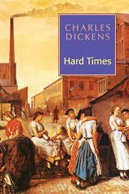
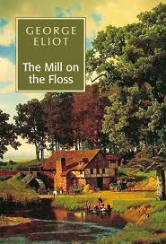

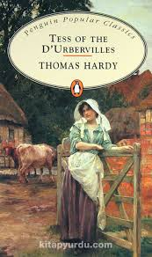



1854
1860
1847*
1891

Slide 3
18th century (Age of Reason)
Novel as a marginal form
Birth of middle class

Slide 4
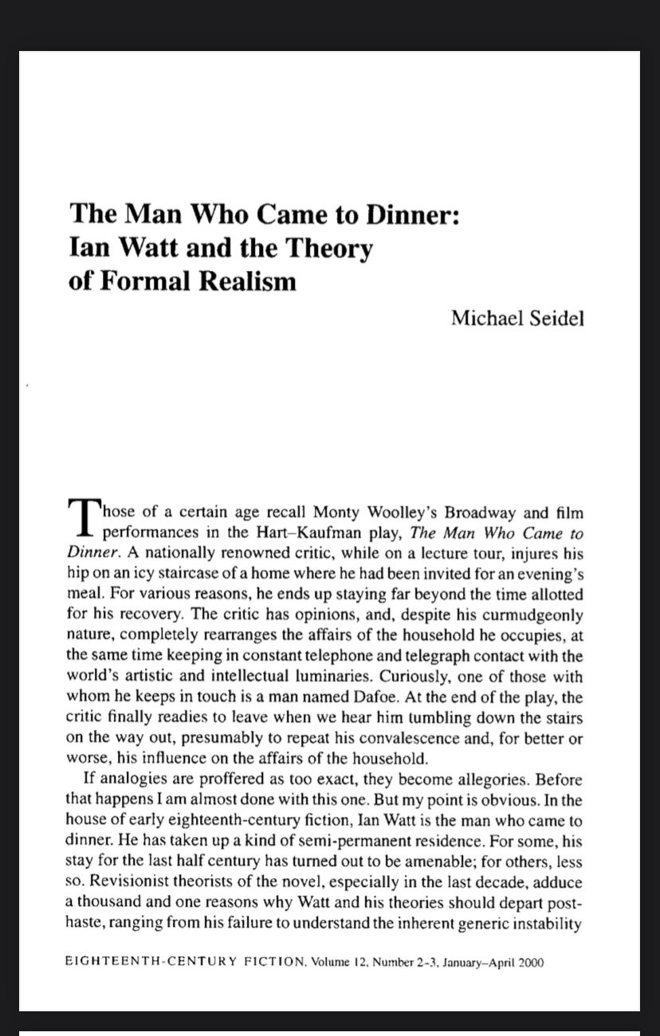
Ian Watt The Rise of the Novel (1957) and Formal Realism
Defoe, Richardson, Fielding went to extraordinary lengths to call their fictional narratives everything under the sun but novels. Novels were associated with romances, and that is precisely the writers of prose narratives in England wished to avoid. The tendency in the early eighteenth century was to lump novels and romances together to the degree that they heightened some of the less believable circumstances of human life, whether the fantastic, the improbable, or the supremely emotional. (Seidel, p.196)

Slide 5
One clear characteristic of formal realism is that it spends less and less time with features of narrative ascribable to miracles, to magic, to inexplicable occurrences, to idealizations of behaviour beyond the probable passions and indulgences of human beings in recognizable settings. Romance, on the other hand, is that mode in which probability is, at best, intermittent. Many of those in the last few decades who have responded to the notions of Watt, for whom probability or circumstantial realism was paramount in defining narrative forms of the early eighteenth century, argue that romance elements are indeed left in much of the fiction of the period. And of course these respondents are right. Paradigms of romance- victimage, forbearance, rescue--remain entrenched in realist fiction. But what is removed are those generic parts of romance that define causality and circumstance by forces inapplicable to the world of conventional experience, as for the twenty-four hours of each romance day are filled with special events answerable only to the powers that produce them. That is, in ro mance, laws of nature and culture are rewritten, sometimes suspended, in concert with the exigencies of peculiar plots and the intense motivations of romance characters -star-struck, doting, or drugged lovers, magical as- sistants, private enforcers, tyrannical overlords, oracles, witches, ghosts, alchemists. (Seidel, p. 196)

Slide 6
Circumstantial view of life
Particularization of time
Concrete setting
It reflects the social panorama
Formal docs, bills, checks
Very similitude of life
Formal Realism/Novel

Slide 7

plot
What is a novel?
Prose writing
Long length
fictional
Protagonist, Antogonist
Round and flat character

Slide 8
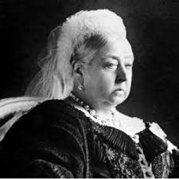
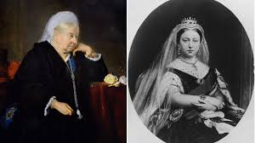

Slide 9
VICTORIAN ERA
“It was the best of times, it was the worst of times, it was the age of wisdom, it was the age of foolishness, it was the epoch of belief, it was the epoch of incredulity, it was the season of Light, it was the season of Darkness, it was the spring of hope, it was the winter of despair, we had everything before us, we had nothing before us, we were all going direct to Heaven, we were all going direct the other way—in short, the period was so far like the present period, that some of its noisiest authorities insisted on its being received, for good or for evil, in the superlative degree of comparison only.”
Charles Dickens, A Tale of Two Cities.

Slide 10
The Industrial Revolution, which took place in England between 1760 and 1840, was a transformation in agriculture, transitioning from an economy based on crafts and manual labor to one dominated by industry and machine production. A key factor in this transition was the invention of the steam engine by a Scotsman named James Watt. This revolution marked a shift in production processes with the introduction of machinery.
The period from 1760 to 1830 is primarily referred to as the First Industrial Revolution, and it was largely confined to England. During this time, the British Industrial Revolution was characterized by the mechanization of production and the shift to a factory system. The revolution began in light industries, particularly textiles, which required less capital and offered quicker returns. Over time, technological innovations and advances in production and organization spread to heavy industry as well. The Industrial Revolution marked a significant shift from human labor-based production, which reached a limited audience, to machine-driven production, which enabled the mass production of goods on a scale never before seen.

Slide 11
Industrial revolution had negative effects on society. The structure of society changed from the agricultural society to a industrialized society, yet this change gave rise to the lost of familiar life and relationship among individuals in big cities as Wordsworth in The Prelude. There was lost of identity; individual became alien to each other; the employment went up; the child labour began; the number of the prostitutes increased on account of two reasons – poverty and desire to be rich; women were exploited through their work force, long working hours and cheap salary.

Slide 12
Victorian Age (The 19th Century)
Darwinism/Imperialism/Colonialism
The aftermath of the Industrial Revolution
A period of social and historical change
Age of contradictions (conservatism vs revolt) (predestination vd freewill) (religion and science)
Rapid changes due to industrialisation
High population in urban cities (London population rose from 2 million to 6.5 million)
Decline of the aristocracy
Decline of agriculture
Rise of the middle class

Slide 13
Rise of the Middle Class
The link between aristocracy and lower classes
Merchants, financers and manufacturers formed the upper middle class.
They were the dominant force who made money by commerce and industry.
Aristocrats’ social power continued longer than their political and financial power.
The shift in social dynamics led to intermarriages.

Slide 14
The novels of Dickens, Disraeli, Elizabeth Gaskell, even Charlotte Bronte, offer the imaginative response to the distress and poverty behind apparent prosperity of society – and a portrayal of the Industrial Revolution in human terms. On the one hand, Industrial Revolution brought about development of modern cities with factories, lights, new transportations systems, newspapers, electronic telegraphs, luxury and richness. Trade developed; middle-class gradually became rich and gained power in society.

Slide 15
EARLY VICTORIAN AGE (1832-1848)
The beginning of the age is the industrial society
Economic and social difficulties associated with Industrial Revolution
«Times of Troubles» (it was characterized by unemployment, poverty, and rioting)
1832-First Reform Bill (enables middle class with certain income to vote)
1840- Repression and Chartist Movement
1846-Corn Law
1838-48- Chartist Movements

Slide 16
NINETEETH CENTURY ENGLISH NOVEL
Reform Bills
Chartism was a working-class movement for political reform in Britain between 1838 and 1848 which took its name from the People’s Charter 1938. The term "Chartism" is the umbrella name for numerous loosely coordinated local groups, often called "Working Men's Association", which peaked in 1839, 1842 and 1848.
It began among skilled artisans in small shops, such as shoemakers, printers, and tailors, and handloom workers in Lancashire and the Midlands as a petition movement which tried to mobilise "moral force" but soon attracted men who advocated strikes, general strikes and physical violence, such as Feargus O’Connor, known as "physical force" Chartists.

Slide 17
NINETEETH CENTURY ENGLISH NOVEL
The People's Charter called for six basic reforms to make the political system more democratic:
A vote for every man over the age of 21;
A secret ballot;
No property qualification for members of Parliament;
Payment for MPs (so poor men could serve);
Constituencies of equal size;
Annual elections for Parliament.
Chartism was a continuation of the 18th century fight against corruption and for democracy in an industrial society.

Slide 18
NINETEETH CENTURY ENGLISH NOVEL
Anti-Corn Law League: A Corn Law was first introduced in Britain in 1804, when the landowners, who dominated Parliament, sought to protect their profits by imposing a duty on imported corn. During the Napoleonic Wars, it had not been possible to import corn from Europe. This led to an expansion of British wheat farming and to high bread prices.

Slide 19
NINETEETH CENTURY ENGLISH NOVEL
Farmers feared that when the war came to an end in 1815, the importation of foreign corn would lower prices. This fear was justified and the price of corn reached fell from 126. 6d. a quarter in 1812 to 65s. 7d. three years later. British landowners applied pressure on members of the House of Commons to take action to protect the profits of the farmers. Parliament responded by passing a law permitting the import of foreign wheat free of duty only when the domestic price reached 80 shillings per quarter (8 bushels). During the passing of this legislation, Parliament had to be defended by armed troops against a large angry crowd.
This legislation was hated by the people living in Britain's fast-growing towns who had to pay these higher bread prices. The industrial classes saw the Corn Laws as an example of how Parliament passed legislation that favoured large landowners. The manufacturers in particular was concerned that the Corn Laws would result in a demand for higher wages.

Slide 20
NINETEETH CENTURY ENGLISH NOVEL
Anti-Corn Law League, founded in 1839, devoted itself to fight England’s Corn Laws and regulations governing the import and export of grain. It was led by Richard Cobden, who saw the laws as both morally wrong and economically damaging.
The league mobilized the industrial middle classes against the landlords, and Cobden won over the prime minister, Sir Robert Peel. The Corn Laws were repealed in 1846.
The Leaguers argued persuasively that repeal of the Corn Laws and subsequent free trade would:
give manufactures more outlets for their products
expand employment
lower the price of bread
make British agriculture more efficient and productive
expose trade and agriculture to foreign competition
promote international peace through trade contact

Slide 21
MIDDLE VICTORIAN PERIOD (1848-1870)
Empowered middle class
Time of prosperity and progress (remember the Great Exhibition in 1851)
Enormous investment of people, money, and technology led to the more powerful British Empire
Darwin’s Original Species (1859)
The Man’s Place in Nature (1863)
Jeremy Bentham’s Utilitarianism* (Laissez-faire)

Slide 22
LATE VICTORIAN PERIOD (1870-1901)
The growing threats to the Empire
Beginning of socialist movement
Karl Marx and Hegel
The literature of the1890s is characterized by self-conscious melancholy and aestehitism
Pessimism since victorian values* were shaken
Beginning of the modernist movement
The growth of periodicals

Slide 23
Cont’d…
Naturalism: Man is conditioned and doomed by his enviroenment.
1871: Union Act
1880- First Labour Party

Slide 24
Women
The Angel in the House (idealized domesticity)
Consumers = the majority of the reading public
Producers = half the writing population
Subject matter = woman’s sphere, domestic and family-oriented plots
Gave voice to women on an equal footing with men
on the other hand
Moral education of the young was a priority
Fallen woman should be punished (or the writer would be punished by the critics)
Some authors satirized the angelic depiction of women (Thackeray)

Slide 25
NINETEETH CENTURY ENGLISH NOVEL
Religion: Barbara Dennis argues that no period in English history has been as religious as the Victorian period. Religion entered any parts of life and thought as in the Middle Ages. What you believed, what you did not, mattered tremendously during the Victorian period. It affected every area of life, public and private, social, political, education and professional. The pervasive spirit of reform and change which was sweeping through society was felt as much in ecclesiastical areas as in all the others, which were inevitably reflected in the novels of the period one way or another.

Slide 26
NINETEETH CENTURY ENGLISH NOVEL
There are two religious movements in the Victorian period
The Oxford Movement: Although the Victorian English society was very much religiously oriented in every aspect of life from politics to art, there had been on-going secularisation process from the Renaissance onward, which had radically split the uniformity of Catholic version of Christianity. Since the spiritual life was getting more and more materialized and rationalized, this situation obviously disturbed the religious establishment, urging them to find the ways to restore the previous position of the religion in life.

Slide 27
NINETEETH CENTURY ENGLISH NOVEL
In this regard, there was especially tendency of politicians to regard the church as part of state, and eventually a group of men at Oxford, notably John Henry Newman, John Keble and Edward Pusey, launched a serious tracts (religious pamphlets) in 1833.
Their activity is named as the Oxford movement, which argued that the Anglican version of Christianity was corrupted and went away from the deep spirituality of religion.

Slide 28
NINETEETH CENTURY ENGLISH NOVEL
The Oxford Movement was simply a movement within the Church of England, originating at Oxford University in 1833, that sought to link the Anglican Church more closely to the Roman Catholic Church or a movement within the Church of England that aimed at emphasizing the church's Catholic inheritance as a source of legitimacy and deeper spirituality.
Its main intent was to defend the Church of England as a divine institution against the threats of liberal theology, rationalism, and government interference. Though some in the movement (notably John Henry Newman and Henry E. Manning) ended up converting to Catholicism, most did not. Their concern for a higher standard of worship influenced not only the Church of England but also other British Protestant sects. The movement was also instrumental in the establishment of Anglican monasteries and convents

Slide 29
NINETEETH CENTURY ENGLISH NOVEL
Evangelical Movement: It was a Protestant movement during the 18th century that stresses conversion experiences, the Bible as the only basis for faith, and evangelism at home and abroad.
The organize religion had been swept by the great Evangelical Revival headed by John Wesley (1703-1791) and his brother Charles (1707-1788) in the previous century, which resulted in the foundation of Methodism; and a similar revival was later felt in the Church of England, a church Wesley had left.

Slide 30
NINETEETH CENTURY ENGLISH NOVEL
Evangelical Movement emphasised good works which promoted great social reforms.
  The faith of Evangelical was personal, and was expressed in strict standards of conduct - good works were an essential part of their code.
  They were less concerned with the outward religious observances than inward vital religion, a deeply felt in the redemption of man from his sinful state made possible through Christ’s death.
  Evangelicalism was very much the religion of the burgeoning middle class who were beginning to run Victorian society. It was a religion which could be easily appropriated by the self-made businessmen who readily acknowledged what they saw as the link between their common individualism and the deeply personal nature of Evangelical religion. It identified clearly with the prevailing utilitarian ethic (Dennis, 2000: 26-27).

Slide 31
RELIGIOUS DOUBT
Religious doubt: although the Victorian period was a highly religious period, religion was also challenged deeply and put into question.
The reasons:
a) The High Criticism of Bible in the light of new development as well as of the growth of science urged a new approach to the Scriptures. This kind of Biblical criticism is the scholarly "study and investigation of biblical writing that seeks to make discerning judgments about these writings". Viewing biblical texts as having human rather than supernatural origins, it asks when and where a particular text originated; how, why, by whom, for whom, and in what circumstances it was produced; what influences were at work in its production; what sources were used in its composition; and what message it was intended to convey.

Slide 32
Cont’d..
b) Charles Darwin’s The Origin of Species (1859) or Theory of Evolution: He was the most notorious of scientists. Darwin’s biological studies obviously shattered the long-standing basis of religion concerning the creation of mankind. In the revealed religions, the first man, the Prophet Adam, was created from soil, and Eve was created from his ribs. The following generations have been produced consequently from the children of Adam and Eve. Individuals became suspicious of the truth of the creation mentioned in the revealed religions.

Slide 33
VICTORIAN NOVEL
*** It seeks to represent a large and comprehensive social world, constructing a tension between social conditions and aspirations of hero and heroine
*record of a society
*John Stuart Mill the age of «Great Change»
*victorian dilemma: spirutality of christian ideals and meterial theory of science
*political power was shifting from the aristocrasy and the middle class to working class
*Social respectibility was associated with financial power ( profitable, capitalism, imperialism)
Influence of the Gothic
Religious and social morality
Conformity to conventions
Virtue rewarded, vice punished
Reading public largely consisting of females, but everyone was reading

Slide 34
Novelists
Jane Austen
Charles Dickens
William M. Thackeray
George Eliot
Elizabeth Gaskell
Thomas Hardy
Anthony Trollope
Oscar Wilde
William Morris
Samuel Butler
George Meredith
Wilkie Collins
George Gissing
Henry James
Benjamin Disraeli

Slide 35
Publications
Three volume novels = three deckers
Circulating libraries (because the working class couldn’t afford them)
Monthly serials
  cliff-hangers
  vivid, memorable characters
  melodramatic plots
  adjusting according to readers’ response

Slide 36
Gothic
Dark romanticism
Attempts to to disturb or unsettle the orderly, civilized course of society
Deals with the dark side of humanity or unveils socio-cultural anxiety
Deals with the uncertainties and contradictions of the psyche
Tales of mystery and horror
Interiors are linked with danger; threats come from within the house, within the family and within the self
Plunges its characters into mystery, torment and fear in order to pose disturbing questions to our familiar and comfortable ideas of humanity, society and the cosmos

Slide 37
References
Abrams, M. H. and Others, eds., The Norton Anthology of English Literature, vol. 2 (New York: W. W. Norton and Company, 1979).
Baker, William, ed., Critics on George on Eliot: Reading Literary Criticism (London: George Allen & Unwin Ltd., 1973).
Blake, Andrew, Reading Victorian Fiction: The Cultural Context and Ideological Context of the Nineteenth-Century Novel (London: Macmillan, 1989).

Slide 38
NINETEETH CENTURY ENGLISH NOVEL
Dennis, Barbara, The Victorian Novel (Cambridge: Cambridge University Press, 2000).
Ford, Boris, ed., The Pelican Guide to English Literature from Dickens to Hardy, vol. 6 (Harmondsworth: Penguin, 1982).
Michie, Elsie B., ed., Charlotte Bronte’s Jane Eyre: A Casebook (Oxford: Oxford University Press, 2006).
Rosenberg, Brian, ‘Character and Contradiction in Dickens’, Nineteenth Century Literature, 47 (1992-93), 145-163.
Watt, Ian, ed., The Victorian Novel: Modern Essays in criticism (Oxford: Oxford University Press, 1971).
Wheeler, Michael, English Fiction of the Victorian Period (London: Longman, 1994).

